Slide 1

Predicting Traffic Stop Outcomes
General Assembly Data Science
Capstone Project
Adeniyi Harrison

Slide 2
So what are we doing?
Predicting incident outcomes of traffic stops based on driver attributes, location information and other incident meta data
Is DWB (Driving While Black/Brown) a real thing?
Outcome Variable: Police Intervention Disposition (Warning, Ticket or Arrested)

Slide 3
Where is the data from?
Subscribed to “Data is Plural”
Connecticut Data Collaborative
http://ctrp3.ctdata.org/
Traffic Stop Data by each police department in Connecticut from Oct 1, 2013 to Sep 30, 2015
Mostly Categorical
Driver Information
Reason for Stop
Result of Stop

Slide 5
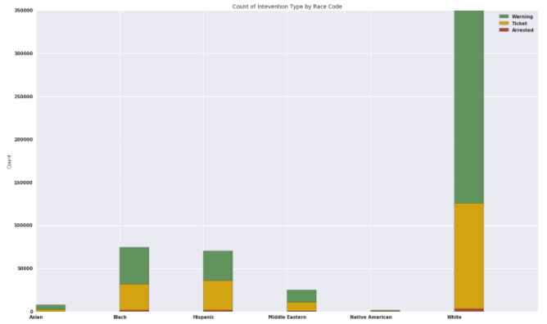
Count of Stops by Racial Groups

Slide 6
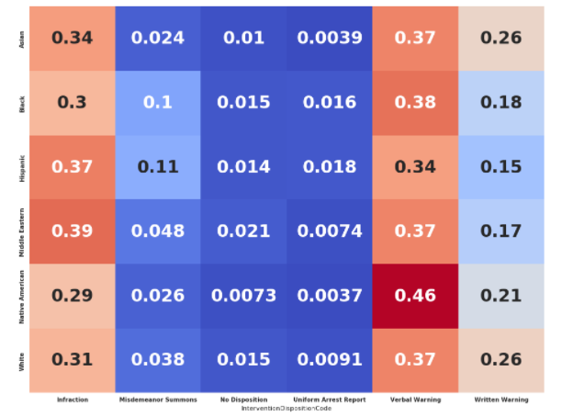
Racial Group and Intervention Result Matrix

Slide 7

Where did we leave off?
Logistic Regression
Outcome Variable: Whether a stop will result in a ticket/arrest or warning
Feature Variables: Race, Sex and Age
Accuracy: 54%

Slide 8
What have I done since?
Google API to convert police departments into geo locations
Scraped Wikipedia Pages to get demographic data to merge to the locations

Slide 9
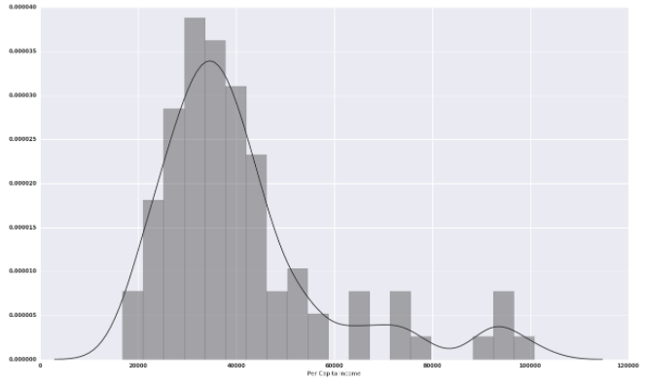
Histogram of Per Capita Income of cities in analysis

Slide 10
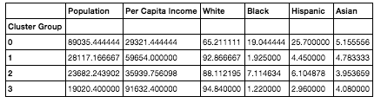
Clustering
Kmeans Clustering
4 Different types of Connecticut Cities
Group 0: Large Population, Low Income City with Large Black and Hispanic Populations (9 Cities)
Group 1: Medium Population, Medium Income City with Large White Population (12 Cities)
Group 2: Small Population, Low Income City with Small Sized Black, Hispanic and Asian Population (41 Towns)
Group 3: Small, Majority White and Wealthy Cities (5 Towns)

Slide 11
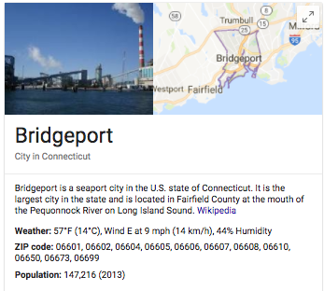
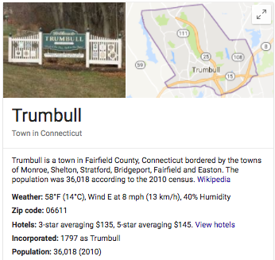
Group 0
Group 1

Slide 12
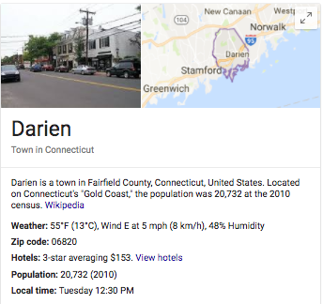
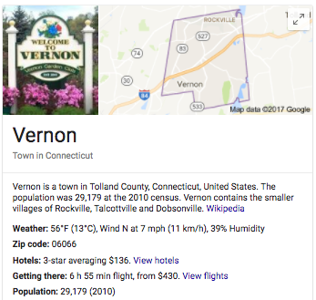

Group 3
Group 2

Slide 13
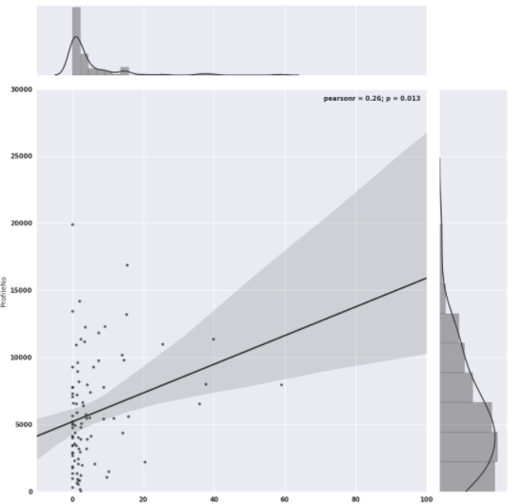
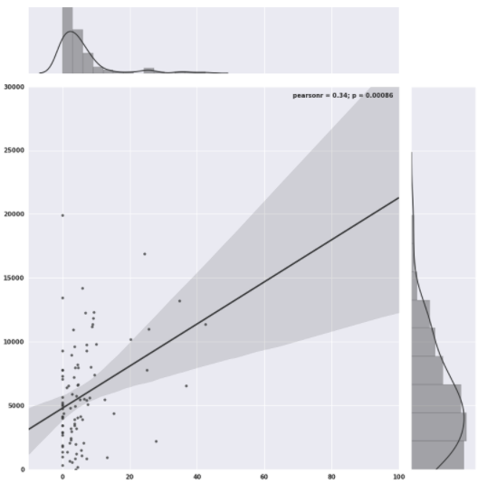
Number of Stops vs. Percentage of Hispanic Population
Number of Stops vs. Percentage of Black Population
R Squared: .26
R Squared: .34

Slide 14
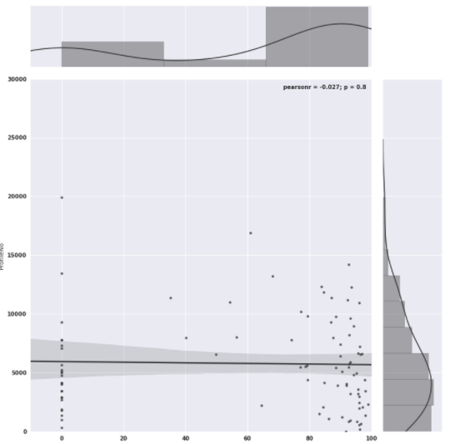
Number of Stops vs. Percentage of White Population
R Squared: -.03

Slide 15
Logistic Regression
Feature Variables: Race Group, Sex, Age, Population, Per Capita Income, Racial Population Percentages
Predicting whether a driver will get a ticket or arrested
Accuracy: 63%
Coefficient Interpretation
Black Drivers are 2% less likely to get a ticket compared to White Drivers
Hispanic Drivers have 12% increased chance of getting a ticket over a White Driver
As a city’s total black percentage population increases by 1 percentage point the chances of any driver getting a ticket increases by 1.17x
Each 1 point increase in Hispanic population the probability is 1.09x

Slide 16
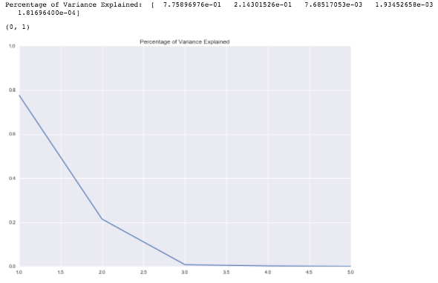
Principal Component Analysis
Feature Variables: Race, Age, Sex, Day of Week, Month ,Resident Indicator, Stop Reasoning, Stop Duration, Vehicle Searched, Vehicle Towed, Demographic data (50 Variables total)

Slide 17
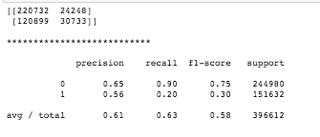
Principal Component Analysis
Logistic Regression with 2 Eigenvalues
No Improvement from original Logistic Regression
Accuracy: 63%

Slide 18
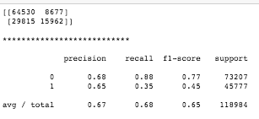
Principal Component Analysis
Random Forest Classifier with 3 Eigenvalues
Accuracy: 68%

Slide 19
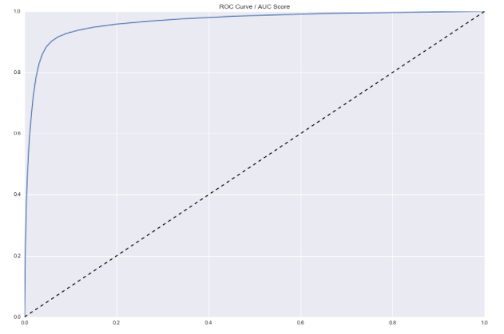

Random Forest Classifier
Feature Variables: Race, Age, Sex, Day of Week, Month ,Resident Indicator, Stop Reasoning, Stop Duration, Vehicle Searched, Vehicle Towed, Demographic data (31 Variables total)
The model is 78% accurate at predicting whether a driver will be ticketed or arrested once pulled over

Slide 20
End.

